Slide 1
Sensor Networks Lab: Introduction
Daniel van den Akker
Notes:
1

Slide 2
Introduction

Slide 3
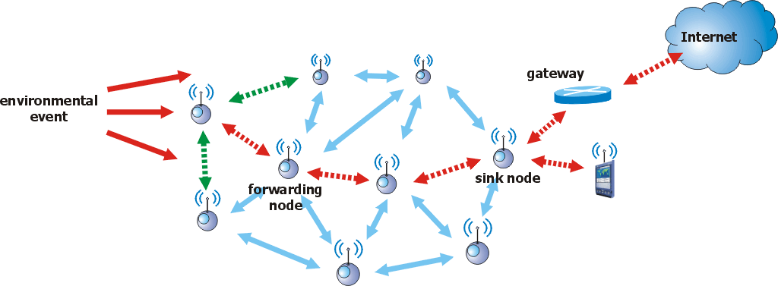
Introduction
Sensor Network:
“A sensor network is composed of a large number of sensor nodes which are densely deployed either inside or very close to the phenomenon of interest”
Notes:
Original idea: ‘smart dust’
-Not too feasible, but some nice applications have emerged
Example: forest monitoring

Slide 4
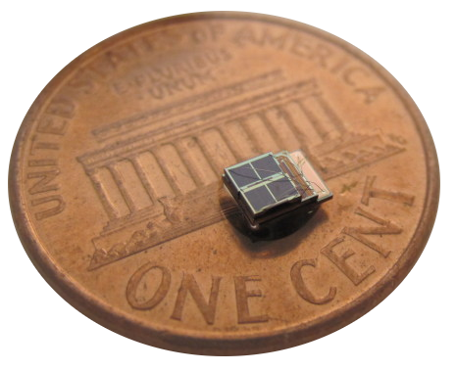
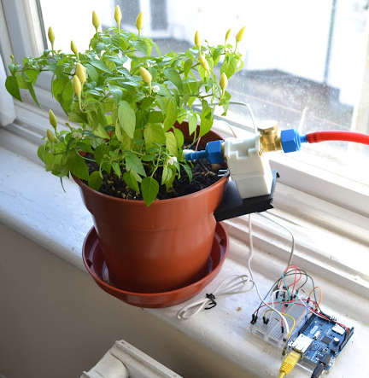
Introduction
Sensor nodes
‘Small’, low power and low cost devices
Consist of sensing, data processing and communication components
Are used to sense the environment
Eg: temperature, humidity, …
Can sometimes be used to interact with the environment
In that case it is called an actuator
http://www.electronicsweekly.com/news/research/device-rd/isscc-rice-grain-solar-sensor-nodes-uses-cortex-m3-2010-02/
http://theon.github.io/plant-watering-with-arduino.html

Slide 5
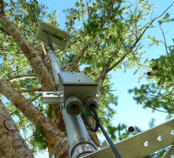
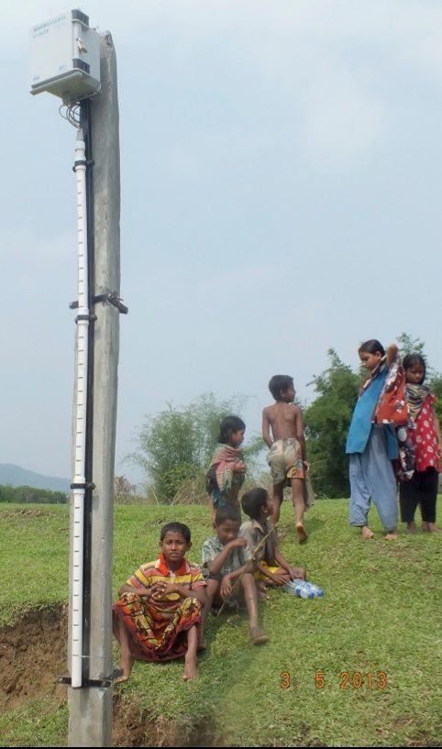
Sensor network applications
Habitat & Agricultural monitoring
Seabird monitoring in Maine’s Great Duck Island^{[1]}
Mesa Network (Climate monitoring)^{[2]}
SERVIR Flash flood detection system^{[3]}
[1] http://www.wired.com/wired/archive/11.12/network.html
[2] https://intelesense.net/customers/uidaho
[3] https://servirglobal.net/Himalaya/Articles/tabid/243/Article/1217/servirs-wireless-sensor-network-wsn-flash-flood-early-warning-system-deployed-i.aspx

Slide 6
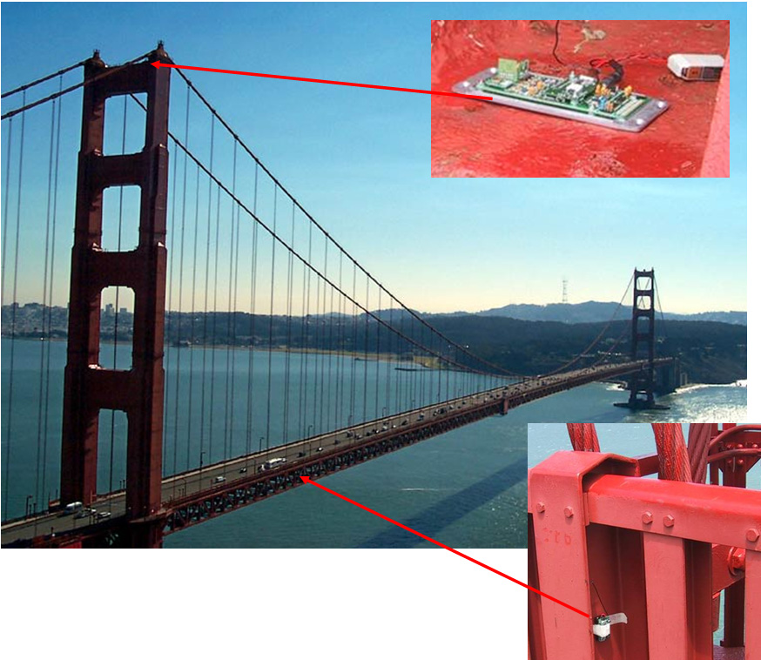
Sensor network applications
Structural and seismic monitoring
Bridges
Highways
Buildings
Examples
Structural Health Monitoring of the Golden gate bridge^{[1]}
UCLA Factor building^{[2]}
[1] http://www.cs.berkeley.edu/~binetude/ggb/
[2] http://factor.gps.caltech.edu/node/61

Slide 7
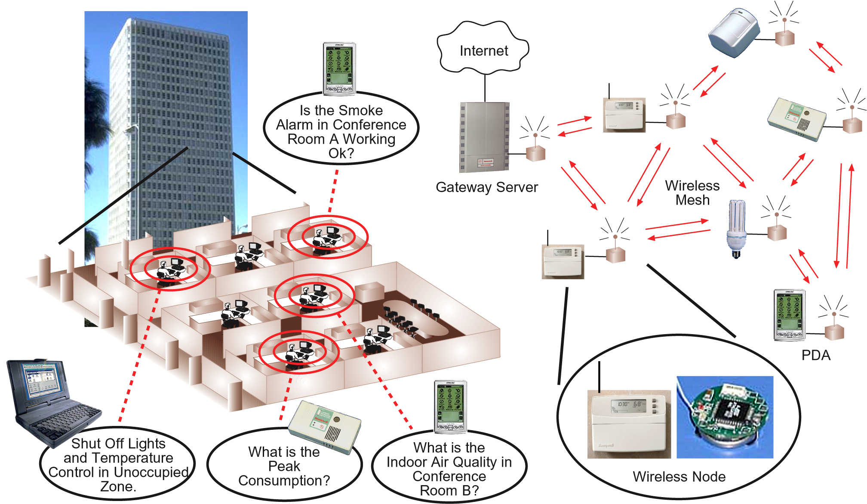
Sensor network applications
Home & Building Automation

Slide 8
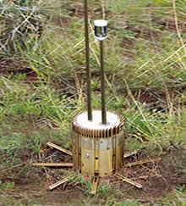

Sensor network applications
Surveillance
Perimeter control
Reconnaissance
Logistics
Trace & Tracking of containers
Smart Environments
Manufacturing
Smart Roads
…
http://defense-update.com/20060107_scout-ugs.html
http://www.libelium.com/wireless_sensor_networks_m2m_logistics_operations/

Slide 9
Sensor network properties
Limited energy sources
Battery powered nodes
Infeasible to replace
Difficult to charge: solar panels, wind, …
Tradeoff between performance and energy usage / lifetime
Nodes are expected to last for years
One-time Ad-hoc deployment
Single or (Limited) Multihop wireless network
Little to no infrastructure available
Self organising & self healing
Limited control over node placement
Post-deployment intervention is difficult or impossible

Slide 10
Sensor network properties
Varying network topologies
Between 10s and 1000s of nodes
Varying density levels
Both static & mobile nodes
Eg: shipping containers being moved
Limited data rates
Periodical reporting of sensor data
Every few minutes to a few times a day
Eg: average temperature & humidity
Occasional traffic bursts
In response to events sensed by the nodes
Eg: temperature indicates a fire

Slide 11
Sensor ⬄ Ad-hoc Networks
 | Sensor Network | Ad-hoc Network
Type | Self organising, Multihop wireless network
Scale | 100+ Nodes | 10-50 Nodes
Memory | 8K – 512K RAM | 1G – 4G RAM
Processing power | 4MHz – 128MHz Microcontroller | ± 1Ghz CPU
Price | Cheap: less than 5€ per node | Relatively expensive: 100 – 200€ per node
Typical energy usage | 0.1mW – 100mW | 5-25W
Dependability | Nodes are prone to failure, network is more important | Node failure should be avoided
Application support | Single Application | Multiple Applications

Slide 12
Energy Usage
Which metric should be optimised ?
Energy per correctly received bit
Including overheads, forwards by nodes, …
Energy per reported (unique) event
After all: the information is important, not the payload bits
Typical for WSN
Network lifetime: “Time until the network is no longer useful”
Time to first node failure
Time to partition
Time to loss of coverage
Time to failure of first event notification
…

Slide 13
Energy Usage
What is more expensive: computation or communication ?
Difficult to compare directly
: between 200 and 2900 (according to literature)
To send one kilobyte ≈ computing three million instructions^{[1]}
Computation is generally preferable to communication
In-network processing:
Exploit compression/coding schemes, …
Aggregation
Tradeoffs:
Eg: Energy ⬄ Accuracy
Optimise the network stack
[1] Pottie, Gregory J., and William J. Kaiser. "Wireless integrated network sensors." Communications of the ACM 43.5 (2000): 51-58.

Slide 14
Other design challenges
QoS constraints
Delay, reliability, …
Depends on the application
Heterogeneity
Not all nodes may have the same capabilities
Adaptability
Changing application requirements
Changing operation conditions (eg: weather)
…
Security & Privacy
Sensor networks collect potentially sensitive information
Are subject to attacks, just like other wireless networks

Slide 15
Network Stack: Physical Layer

Slide 16
Physical Layer
IEEE 802.15.4:
Standard for low-power Wireless (Personal) Area Networks
Frequency bands:
433MHz, 780MHz, 868MHz, 915MHz, 950MHz
Different bands available in different countries
Data rates: 20 – 250kbit/sec
ISM Band: 2.4GHz
Available worldwide
Data rates: 250 – 1000kbit/sec
UWB
Packet size: max 127 bytes
Range: between 10m – +1km
Depends on frequency band, modulation, obstacles, …
Notes:
IEEE 802.15.4: eg used in philips hue lamps; lots of ‘remote controllable’ IKEA devices
Especially on 443 long ranges are possible: right data rate && right antenna: 1.5km not really an issue

Slide 17
Physical Layer
IEEE 802.15.4 ⬄ Wifi
Overlapping channel allocation^{[1]}:
Different PHY Parameters:
Parameters | IEEE 802.15.4 | IEEE 802.11b
Tx Power | 0 dBm (1mW) | 20 dBm (100mW)
Channel width | 2MHz | 22MHz
CCA Threshold | -75 dBm | -82 dBm
[1] Liang, Chieh-Jan Mike, et al. "Surviving wi-fi interference in low power zigbee networks." Proceedings of the 8th ACM Conference on Embedded Networked Sensor Systems. ACM, 2010.

Slide 18
Physical Layer
IEEE 802.15.4 ⬄ WiFi
IEEE 802.15.4 is severely affected by interference from WiFi networks^{[1]}
Mitigation strategies:
Use a channel not used by any WiFi networks (if available)
IEEE 802.15.4e: channel hopping
[1] Liang, Chieh-Jan Mike, et al. "Surviving wi-fi interference in low power zigbee networks." Proceedings of the 8th ACM Conference on Embedded Networked Sensor Systems. ACM, 2010.

Slide 19
Physical Layer
Other Transmission technologies used
UMTS/GSM
Extremely low frequency data reporting in urban environments
LoRa
Extremely long range: Urban: 2km+, Rural: 10km+
Extremely low bitrate: 300 bit/sec
Requires proprietary radio chip
SigFox
Range: Urban: 3km+, Rural: 30km+
Extremely low bitrate: 10 – 1000 bit/sec
Sensors can use ‘default’ radio chips
Basestations are proprietary
Notes:
300 bit/sec -> Takes 4 seconds just to transmit a twitter msg

Slide 20
Network Stack: Medium Access Control (MAC) Layer

Slide 21
MAC Layer
Energy efficiency:
Primary Design goal: Minimise energy consumption
Radio States
Try to SLEEP as much as possible
“Duty Cycle” = fraction of the time the radio is ‘active’
State | Description | Typical power drawn^{[1]} | Time needed to switch to RX state^{[1]}
OFF | Radio is completely disabled No RX / TX Possible Startup takes a significant amount of time | 0 mA | 5 – 10 ms
SLEEP | Some hardware functions disabled No RX / TX Possible Radio can quickly change to RX state | 0.426 mA | 0.192ms
RX | Radio is actively scanning for packets to receive | 18.8 mA | 0
TX | Radio is transmitting a packet | 8.5 – 17.4 mA | 0.192ms
[1] http://www.ti.com/product/cc2420

Slide 22
MAC Layer
Sources of energy waste
Idle Listening:
Radio is in RX state while not receiving packets
Overhearing
Receiving packets destined to other nodes
Keeps the CPU busy unnecessarily
Prevents the CPU from entering its ‘low power’ mode
Problematic for high network loads / high network density
Collisions:
Retransmissions prolong the ‘active’ time of the radio
Control Traffic

Slide 23
Other design goals
Scalability
Sensor networks consist of 100+ nodes
Varying density levels
Adaptability
Mobile nodes, Channel conditions change over time
Varying traffic patterns: Periodic reporting ⬄ Event triggered
Robustness
Sensors fail all the time, MAC should be able to cope
Quality of Service
Usually not too important as long as a minimum quality is achieved
Eg: 95% loss is not acceptable under any circumstances
Notes:
Depend on specific application; not all of them are important for each use case

Slide 24
TDMA MAC protocols
Time Division Multiple Access (TDMA)
Divide the channel into repeating (super-)frames
Each frame consists of N slots
Nodes are assigned specific slots for packet reception & transmission
Easily combined with frequency hopping
Very energy efficient
Radio is only on when transmitting or receiving
No idle listening, No overhearing
Collision free
Built-in QoS support
TDMA Slot allocation can be calculated according to specific delay & throughput constraints

Slide 25
TDMA MAC protocols
Time Division Multiple Access (TDMA)
Difficult to apply to sensor networks
TDMA Requires:
Precise time synchronisation (0.25ms – 0.5ms)
Nodes to agree on the slot allocation
Simple for single-hop, difficult for (large-scale) multi-hop networks
Nodes are resource constrained
Limited scalability & adaptability
Slot allocation changes when nodes join/leave
Frame length is fixed, number of nodes can change over time

Slide 26
TDMA MAC protocols
Cluster-based TDMA protocols
Organise the network into different clusters
A single cluster is effectively a single hop network
“Clusterhead”: controls communication within the cluster
Provides timing & TDMA slot allocation within the cluster
Similar to a WiFi access point
Inter-cluster communication:
Use a different radio
Hierarchical clustering
Examples: LEACH, SS-TDMA

Slide 27
TDMA MAC protocols
Multi-hop TDMA mechanisms
Time Synchronisation
Hierarchical: synchronise according to predefined tree
Broadcast based:
All nodes broadcast timing information
Nodes adjust their clocks to minimise drift wrt. their neighbours
Slot Allocation
Centralised solutions:
Slot assignment determined by central controller
Distributed algorithms:
Collision based reservation
Distributed graph colouring
…

Slide 28
TDMA MAC Protocols
Further Reading
W.B. Heinzelman, A.P. Chandrakasan and H. Balakrishnan. An application-specific protocol architecture for wireless microsensor networks. IEEE Transactions on Wireless Communications, 1(4):660–670, October 2002.
Kulkarni, Sandeep S., and Mahesh Arumugam. "SS-TDMA: A self-stabilizing MAC for sensor networks." Sensor network operations (2006).
Assegei, Fasika A. "Decentralized frame synchronization of a TDMA-based wireless sensor network." Master's Thesis, Eindhoven University of Technology, Department of Electrical Engineering (2008).
Chen, Zhihui, and Ashfaq Khokhar. "Self organization and energy efficient TDMA MAC protocol by wake up for wireless sensor networks." Sensor and Ad Hoc Communications and Networks, 2004. IEEE SECON 2004. 2004 First Annual IEEE Communications Society Conference on. IEEE, 2004.
Herman, Ted, and Sébastien Tixeuil. "A distributed TDMA slot assignment algorithm for wireless sensor networks." Algorithmic Aspects of Wireless Sensor Networks. Springer Berlin Heidelberg, 2004. 45-58.

Slide 29
Contention-based MAC Protocols
Contention-based MAC Protocols
Channel is shared amongst all nodes
Nodes contend with each other for channel access
Advantages
Easier to implement
Better Adaptability & Scalability
More resilient to node failures
Little to no time synchronisation required
Disadvantages
Less energy efficient: Idle listening, overhearing, collisions
Bandwidth utilisation & QoS support not as good as TDMA

Slide 30
Contention-based MAC Protocols
CSMA/CA
Versatile and easy to implement
Extremely wasteful of energy
Radio must be kept on the entire time !
Still used to this day
Often in combination with power reduction schemes at higher layers
S-MAC
One of the earliest “true” sensor network MAC protocols
Combines CSMA/CA with a periodic listen/sleep cycle
Collision & Overhearing avoidance

Slide 31
Contention-based MAC Protocols: S-MAC
S-MAC
Frame = one complete sleep cycle
frameTime: total length of the frame
activeTime: length of the listen interval
Frames are not necessarily synchronised between nodes
Packets are sent during the listen period of the receiver
frameTime
Node A:
Listen
Sleep
Listen
Sleep
Listen
Sleep
time
activeTime
Packet transmission
Node B:
Sleep
Listen
Sleep
Listen
Sleep
Listen
time

Slide 32
Contention-based MAC Protocols: S-MAC
Sleep scheduling
Each node
Maintains a schedule table containing the sleep schedules of its neighbours
Announces its own sleep schedule by broadcasting a ‘SYNC’ packet every few frames
Periodically listens for an entire frame to discover new neighbours
Nodes try to synchronise to a common sleep schedule
At startup, nodes adopt the first schedule they hear
If no schedule is received after a ‘random’ time, a new schedule is started
Notes:
Synchronisation needed just like with TDMA but precision requirements are more ‘relaxed’

Slide 33
Contention-based MAC Protocols: S-MAC
Schedule creation
Synchroniser: First node to transmit a schedule
Followers: Nodes adopting this schedule
Re-broadcast the schedule after a random delay
This allows more distant nodes to follow the schedule
Multiple schedules may exist
Synchronisation wave may not reach entire network in time
Nodes adopt all schedules they hear but only broadcast their ‘primary’ schedule
Schedule 1
Schedule 2
Schedule 1+2
Notes:
Q: why wait for a random delay ?
A:: to prevent ‘flooding’ at startup

Slide 34
Contention-based MAC Protocols: S-MAC
Contention resolution in S-MAC:
Same as in IEEE 802.11
Broadcast: CSMA/CA only
Unicast: also use RTS – CTS – DATA – ACK
Nodes overhearing RTS/CTS go to sleep
Reduces idle listening, overhearing
RTS – CTS overhead:
RTS – CTS creates at least 41% overhead !!
1884µs
4512µs
RTS
CTS
Data
ACK
19 bytes
19 bytes
max 127 bytes
time
5 bytes
SIFS
Notes:
Note: S-MAC was designed in the pre IEEE 802.15.4 era,
For radios supporting near ‘infinite’ packet lengths

Slide 35
Contention-based MAC Protocols S-MAC
How to reduce RTS – CTS overhead ?
Disable RTS – CTS: also done in IEEE 802.11 for smaller frames
Buffer packets & send them in a burst: RTS – CTS is only performed once
Advantages
Duty cycle can be tuned by setting frameTime & activeTime
Single node failure does not affect other nodes
Disadvantages
Limited scalability: neighbour tables grow with the network density
S-MAC does NOT adapt to changing bandwidth requirements
frameTime & activeTime are set during deployment
Bandwith requirements are not the same in the entire network
Bandwith requirements may change over time
Successor: T-MAC ≈ S-MAC with traffic-adaptive listen period

Slide 36
Low power listening MAC Protocols
Low power listening protocols
Nodes periodically wake up and check for channel activity
Activity detected → stay awake for a specific listenTime
No activity detected → go back to sleep for a specific sleepTime
Sending a packet
prefix the packet with a ‘busy’ signal to wakeup the receiver
The busy signal needs to be at least sleepTime long
Sender:
Busy signal
Data
Receiver:
Listen
Notes:
Lots of different ways to generate a busy signal

Slide 37
Low power listening MAC Protocols
May different low power listening MAC protocols exist
B-MAC: The first of the low power listening protocols
Uses a very long preamble to wakeup nodes
Only works with very specific radios
X-MAC: Uses short ‘probe’ packets to wakeup the receiver
Probes contain the destination address → only receiver is woken up
Probes can be acknowledged → less probes need to be sent
LPL-MAC (TinyOS)
Data packet are sent multiple times to wakeup the receiver
CSMA/CA is used for each individual packet
ContikiMAC (Contiki OS)
Data packet are sent multiple times to wakeup the receiver
Nodes try to learn when a node is awake (to minimise wakeup packets)
…

Slide 38
Low power listening MAC Protocols
Advantages
Easy to implement
Very robust: no synchronisation needed
Can adapt to varying traffic requirements
Disadvantages
All nodes are woken up regardless of the intended recipient
Not suitable for:
High network densities
Networks with elevated bandwidth requirements
Depends on specific protocol & implementation

Slide 39
Contention-based MAC Protocols
Many other MAC Protocols exist
C-MAC, L-MAC, O-MAC, P-MAC, SCP-MAC, WiseMAC, Y-MAC, Z-MAC, …
Further reading:
S-MAC: Ye, Wei, John Heidemann, and Deborah Estrin. "Medium access control with coordinated adaptive sleeping for wireless sensor networks." Networking, IEEE/ACM Transactions on 12.3 (2004): 493-506.
T-MAC: Van Dam, Tijs, and Koen Langendoen. "An adaptive energy-efficient MAC protocol for wireless sensor networks." Proceedings of the 1st international conference on Embedded networked sensor systems. ACM, 2003.
B-MAC: Polastre, Joseph, Jason Hill, and David Culler. "Versatile low power media access for wireless sensor networks." Proceedings of the 2nd international conference on Embedded networked sensor systems. ACM, 2004.
X-MAC: Buettner, Michael, et al. "X-MAC: a short preamble MAC protocol for duty-cycled wireless sensor networks." Proceedings of the 4th international conference on Embedded networked sensor systems. ACM, 2006.

Slide 40
MAC Protocols: IEEE 802.15.4
IEEE 802.15.4 (2006)
The first ‘standard’ MAC Protocol for low-power wireless networks
Nodes are organised into multiple Personal Area Networks (PAN)
Two modes of operation
Non-Beaconed Mode ≈ CSMA/CA
Beaconed Mode: Channel is divided into superframes
Controlled by a (PAN) controller
Length of the active / sleep period is determined by the controller
Contention Access Period: CSMA/CA
Contention Free Period: TDMA slots allocated by the controller
Beacon
Beacon
Contention Access Period
Contention Free Period
Inactive period
Active Period
Sleep Period
Notes:
Standardisation & adoption has been very slow:
-first standard quite complicated & only suited for infrastructured networks
→ Partial implementations or replaced by different protocol entirely
-Now: standardisation is becoming more important, but standard has also grown
-eg: support for tdma-only operation (not previously available)
-also limited: TDMA frames defined, but not how slot allocation is to be performed
-infeasible to implement all of it
-not really an agreed upon ‘you MUST implement this’ subset
→ Many incomplete & semi-compliant implementations remain

Slide 41
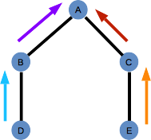
MAC Protocols: IEEE 802.15.4
IEEE 802.15.4 (2015): TSCH
Multi-Frequency TDMA (MF-TDMA) with frequency hopping
TDMA slot-structure is expanded to multiple channels
Each slot is identified by a slotId and a channel offset
Frequency hopping: the TX-frequency changes every slot
Pseudo-random hopping sequence
slot-frequency is calculated from the slotId and the channel offset
slotId
 | 0 | 1 | 2 | 3 | 4 | 5 | 6 | …
0 | SS | SS |  | SS |  | SS
1 |  |  | E→C
2 |  | D→B
3 |  |  |  |  | B→A
4 |  |  |  |  |  | C→A
5
channel offset
Notes:
Other modes exist as well: only discuss TSCH here

Slide 42
MAC Protocols: IEEE 802.15.4
IEEE 802.15.4 (2015): TSCH
Two types of slots:
Dedicated slots: only used for unicast traffic
Shared slots: used mainly for sending beacons & broadcast traffic
All nodes must listen to these slots
Must have channel offset = 0
Synchronization:
Nodes transmit beacons during shared slots
Nodes synchronize to:
Beacons from other nodes ‘closer’ to the PAN coordinator
Unicast data transmissions
Internal clock is adjusted so average drift is minimized
Note: IEEE 802.15.4 does not specify how unicast slots should be allocated

Slide 43
IEEE 802.15.4: Frame format
PHY
MAC

Slide 44
IEEE 802.15.4: Frame format
MAC Frame
At most 127 bytes long (not including length byte)
Designed for compression:
Addressing: 16/64 bit
Long addresses are (assumed to be) unique
Short addresses are assigned by the PAN coordinator and are only valid within the PAN
Four types of encryption each with it’s own overhead
Only destination PAN ID is present if equal to source PAN ID
MAC Overhead (data frames): 11 – 37 bytes
More Information: IEEE 802.15.4-2015
http://standards.ieee.org/getieee802/download/802.15.4-2015.pdf

Slide 45
Network Stack: Routing Layer

Slide 46
Routing Protocols
Early protocols: borrowed from Ad-hoc networks
Proactive protocols (OLSR, DSDV)
Routes are advertised periodically in the network
Each node maintains routes to all other nodes
Reactive protocols (AODV, DyMO)
Routes are discovered on-demand by flooding the network
Nodes only maintain routes in which they are participating
AODV example:
RREQ dest=E
n. Hops=1
RREQ dest=E
n. Hops=1
C
NH(A)=A
RREQ dest=E
n. Hops=0
NH(E)=D
RREQ dest=E
n. Hops=0
RREQ dest=E
n. Hops=2
RREQ dest=E
n. Hops=2
A
RREQ dest=E
n. Hops=2
D
E
RREP
dest=A
NH(E)=C
NH(A)=C
NH(A)=D
RREQ dest=E
n. Hops=1
RREQ dest=E
n. Hops=1
NH(E)=E
B
NH(A)=A

Slide 47
Routing Protocols
Shortcomings of MANET Protocols for sensor networks
Proactive protocols
Routing table size grows with the number of nodes in the network
Not feasible for large scale sensor networks
Route discovery & maintenance: uses periodic route advertisements
Either too slow to react to changes or too bandwidth & energy consuming to even consider
Reactive protocols
Routing table
Smaller than with proactive protocols
Can still be quite large
Flooding based route discovery
All nodes are woken up each time a route is needed or updated
Can cause severe congestion in dense networks
Can detect & repair broken paths
Route repair uses flooding
Notes:
Flooding based issues example:
100+ node network
Imagine what would happen at network startup when all nodes try to establish a route to the sink node at the same time ?

Slide 48
Routing Protocols
Some design challenges
Scalability, Adapability, Fault tolerance, Connectivity, Coverage, …
Find a good energy ⬄ route quality tradeoff
Maintaining good routes is usually quite expensive
Cope with different traffic patterns: Eg: event-based ⬄ periodic reporting
Heterogeneity: nodes may have different capabilities
Eg: more/less energy reserves, cpu, memory, …
The routing protocol should exploit these differences if possible
Data aggregation:
Routes should be optimised to allow maximum agregation within the network
The exact challenges depend on
The application requirements
The network architecture
Notes:
Important: stress that the challenges to overcome depend on the application !!
Eg: if no data agregation is possible, the routing protocol does not need to optimise for this

Slide 49
Routing Protocols
Sensor network routing protocols
Many different types & paradigms exist
Some examples:
Hierarchical & Heterogeneity-based
Different nodes perform different roles
Eg: Clustering
Location-based: exploit node locations to find routes
Multipath-based
Mobility-based
Data-centric protocols
Regard the network as a huge distributed data base
Route ‘queries’ and ‘responses’ according to the contents of the message
Notes:
Hierarchical goes hand in hand with heterogeneity. Example: clustering: divide the network into different clusters
All low-power sensor nodes connect to a high powered cluster head, inter-cluster comms done using for instance wifi
Multipath based: maintain multiple routes to the same destination
-redundancy: faster route repair when node fails
-even spreading of eneregy usage
Mobility based: optimise routing protocol for mobile nodes and ‘MOBILE SINKS’
-eg: instead of having expensive multihop forwarding, have a drone fly over the network twice a day to connect stats

Slide 50
Routing Metrics
Which metric should be optimised when choosing routes ?
Depends on the requirements of the application
Two important types of metrics:
Energy Usage
End-to-End Reliability
Some mathematical notations used
: Energy cost of sending a packet from node i to node j
: Reliability of link i ➞ j
: routing path
: route cost for sending a packet over link i ➞ j
: route cost for sending a packet over routing path p
: Remaining battery fraction of node i
Notes:
Note: may other types of metrics exist besides energy usage & reliability, but these are generally regarded as the most important ones

Slide 51
Routing Metrics
Hop Count:
Tries to cover as much ‘distance’ as possible with each hop
Selects very unreliable links
Unusable for most types of wireless networks
Hop Count with blacklisting:
Prune all links below a certain reliability threshold
Links are guaranteed to have a certain minimum reliability
Can easily cause network partition

Slide 52
Reliability Metrics:
End-to-end reliability
Ensures the best reliability possible
No penalty for adding extra hops
Has a tendency to result in very long paths
Does not take asymmetric links into account
Forward path will be different from the reverse path

Slide 53
Reliability Metrics
Expected Transmission Count (ETX)
“The expected number of PHY layer packets that need to be transmitted to send a single packet over the link”
Trade-off between hop count & reliability
Will generally use high quality links
Lower quality links are used when needed
Allows for asymmetric links
Designed specifically for CSMA/CA
May not work well with other MAC Protocols
Notes:
Explain: etx considers both data & ack packets, if either gets lost the packet needs to be retransmitted
Also: etx expects the MAC protocol to be able to do retransmissions, and implicitly assumes that the MAC protocol will keep trying to send the packet until it is acknowledged. In reality this is not the case: the MAC protocol
Only tries to send the packet a limited number of times. This should be taken into account

Slide 54
Estimating Link Reliability
Efficient routing requires the Link Reliability to be known
Varies with distance between sender & receiver^{[1]}
Changes over time^{[1]}
[1] Woo, Alec, Terence Tong, and David Culler. "Taming the underlying challenges of reliable multihop routing in sensor networks." Proceedings of the 1st international conference on Embedded networked sensor systems. ACM, 2003.

Slide 55
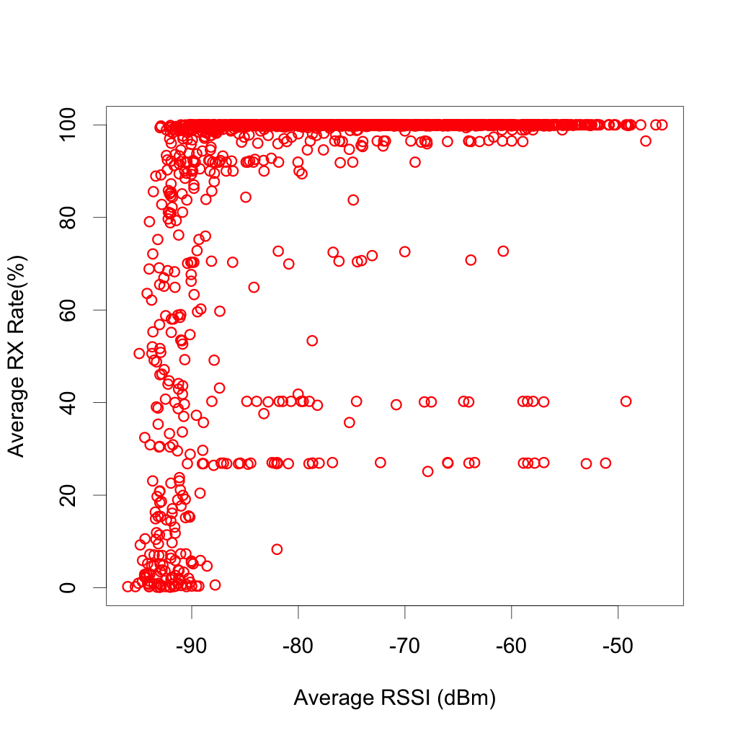
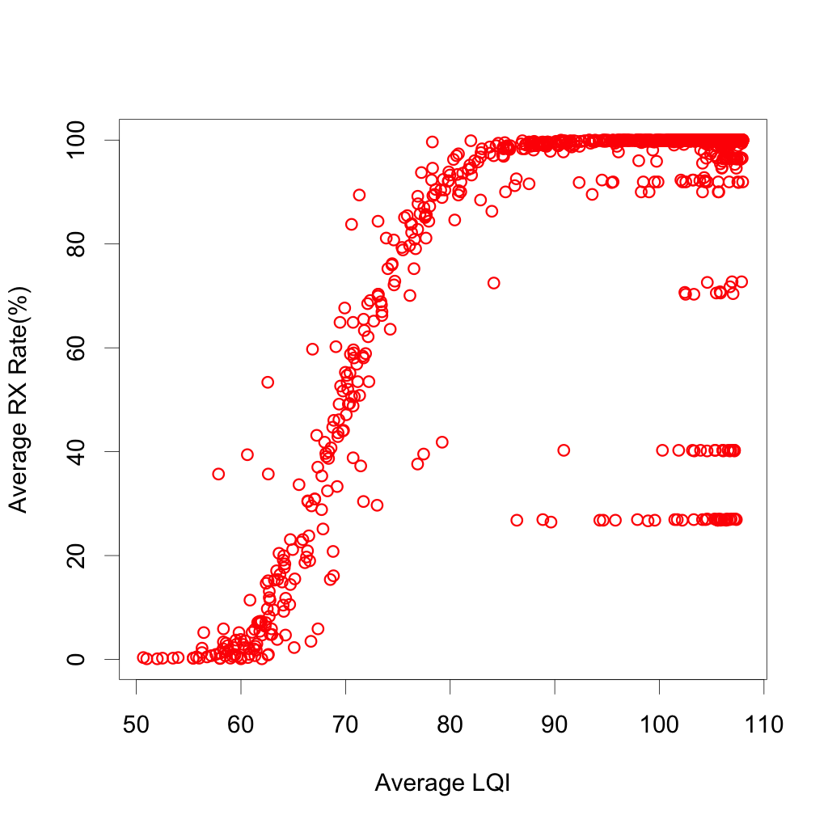
Estimating Link Reliability
Can we use PHY Layer packet statistics ?
RSSI & LQI provide an indication of the link quality
Very noisy → Cannot be used directly for reliability calculations
Notes:
Note that this does not mean that they are useless:
Flaws can be compensated for: eg: blacklisting bad links when they are detected

Slide 56
Estimating Link Reliability
Probing
Broadcast packets to measure the reliability directly
Provides an estimate of the true reliability of the links
Communication overhead can become quite large
Link qualities vary over time → estimates must be adjusted
Precision of the estimate increases with the number of packet sent
Can be combined with other techniques to minimise overhead
Further reading:
Woo, Alec, Terence Tong, and David Culler. "Taming the underlying challenges of reliable multihop routing in sensor networks." Proceedings of the 1st international conference on Embedded networked sensor systems. ACM, 2003.
Gnawali, Omprakash, et al. "Interaction of retransmission, blacklisting, and routing metrics for reliability in sensor network routing." Sensor and Ad Hoc Communications and Networks, 2004. IEEE SECON 2004. 2004 First Annual IEEE Communications Society Conference on. IEEE, 2004.
Woo, Alec, and David E. Culler. Evaluation of efficient link reliability estimators for low-power wireless networks. Computer Science Division, University of California, 2003.

Slide 57
Energy Metrics:
Minimum Transmission Energy
,
Minimizes the ‘global’ energy usage
Does not take battery levels into account
Nodes along the MTE-path die first
Limited battery lifetime
Maximum-Minimum battery cost routing
,
Minimizes traffic through nodes with minimal remaining energy
Does not optimise overall energy usage of nodes with sufficient residual energy

Slide 58
Energy Metrics:
C_{i,j}=e_{i,j}\left ( \lambda^{\left (1-E_{i}\right )} -1\right )
Some more advanced metrics
For all metrics:
^{[1]}
Tuning parameter: λ
Importance of energy cost increases exponentially with used energy
^{[2]}
Tuning parameters: α, β
Only considers energy cost of sender, not of the receiver
Generalised version: ^{[3]}
, : cost of sending & receiving over link i → j
C_{i,j}=\left (e_{i,j} \right)^{\alpha}\left (E_{i}\right )^{\beta}
C_{i,j}=\left (e_{i,j}^s \right)^{\alpha}\left (E_{i}\right )^{\beta} + \left (e_{i,j}^r \right)^{\alpha}\left (E_{j}\right )^{\beta}
[1] https://www.cs.uni-paderborn.de/fileadmin/Informatik/AG-Karl/Lehre/SS12/Sensys/slides/sensys-ch11-id-centric-routing.pdf
[2] Shah, Rahul C., and Jan M. Rabaey. "Energy aware routing for low energy ad hoc sensor networks." Wireless Communications and Networking Conference, 2002. WCNC2002. 2002 IEEE. Vol. 1. IEEE, 2002.
[3] Chang, Jae-Hwan, and Leandros Tassiulas. "Maximum lifetime routing in wireless sensor networks." IEEE/ACM Transactions on Networking (TON) 12.4 (2004): 609-619.

Slide 59
Routing Protocols
Further reading:
Akkaya, Kemal, and Mohamed Younis. "A survey on routing protocols for wireless sensor networks." Ad hoc networks 3.3 (2005): 325-349.
Singh, Shio Kumar, M. P. Singh, and D. K. Singh. "Routing protocols in wireless sensor networks–A survey." International Journal of Computer Science & Engineering Survey (IJCSES) Vol 1 (2010): 63-83.

Slide 60
Routing Protocols: RPL
Observation: In sensor networks traffic flows mostly between the nodes and one or more ‘sink’ nodes connected to the backend.
RPL: IPv6 Routing Protocol for Low-Power and Lossy Networks (RFC 6550)
First standardised routing protocol for low-power (sensor) networks
Optimised for:
Multipoint-to-point (mp2p): node-to-sink data reporting
Point-to-multipoint (p2mp): directed queries, software updates, …
Scalable & adaptable, low overhead
Allows multiple routes to be maintained
Different routes can be optimised for different objectives
Decouples routing protocol from link selection strategy
Extended encryption & authentication support
Notes:
Mention it’s for IPv6 & that doing IPv6 stuff will be explained later

Slide 61
RPL: DAGs & DoDAGs
RPL:
Builds & maintains a Directed Acyclic Graph (DAG)
Consists of multiple Destination Oriented DAGs (DoDAGs)
DoDAG = DAG with single root (sink node)
RPL operation is the same for each DoDAG
→ we only consider a single DoDAG in the slides

Slide 62
RPL: Node Rank
Each Node has a Rank within the DoDAG
Rank ≈ Distance to root node
Conceptually a fixed-point decimal number
Only the integral part is used to compare node locations in the DoDAG
Node A can only be a parent of Node B ⬄ DAGRank(A) < DAGRank(B)
DAGRank(B) must be larger than the largest DAGRank in it’s parent set
If two nodes have the same DAGRank, neither may be a parent of the other
This is to avoid routing loops
R=1
R=2.3
R=2.9
R=4.1
R=3.2
R=5.1
Notes:
Important: in the specs RANK is defined as a 16 bit integer and not a fixed-point decimal.
In all rank calculations howve r it is divided by a configurable constant (MinHopRankIncrease)
And the manner in which it is used is therefore conceptually the same as using a fixed point decimal

Slide 63
RPL: Objective Functions
RPL uses an Objective Function (OF) to
Calculate the Node Rank
Decide which neighbors to use as parents
This separates the route selection strategy from the operation of the routing protocol
Objective Functions
Can make use of a wide range of node & link metrics
RFC6551: Energy, Latency, Reliability, Throughput, …
Others can be defined as needed
Standardized OFs: RFC6552, RFC6997
RPL also allows the OF to be built from scratch
All nodes in the same DAG must use the same OF
Notes:
Explain: the OF should also not be too ‘jittery’ in its calculations to keep routes stable

Slide 64
RPL: DIO Messages
DoDAG Information Object (DIO)
Contains:
DoDAG configuration: DoDAG id, DoDAG seq.nr, OF, …
Rank of the sending node
Node & Path metric containers (to be used by the OF)
Used by RPL to build & maintain the DoDAG
Periodically broadcasted using a ‘Trickle Timer’ (RFC 6202)
High TX rate during network setup & when inconsistencies are detected
This includes configuration changes, node movement, …
TX rate is gradually reduced as the network stabilises
DIO messages are transmitted in an RPL ICMPv6 container
Notes:
DIO == Similar to route advertisements in Proactive routing protocols

Slide 65
RPL: DoDAG Construction
DoDAG Construction
Root node joins DoDAG with Rank=1
All DoDAG members periodically broadcast DIOs
All Nodes maintain a neighbour list
Based on received DIOs or other discovery techniques
Objective Function
Selects the parents from the neighbour list
Sets the rank of the node
After joining the node starts broadcasting DIOs
The root can initiate a new DoDAG by increasing the DoDAG Seq.Nr
A
A
DIO
DIO
B
B
DIO
DIO
C
C
DIO
DIO
DIO
D
D
DIO
DIO
DIO
E
E
DIO
DIO
 | A | B | C | D | E | F
Neighbours | B,C | A,D,E | A,D,E | B,C,F | B,C,F | D,E
Parents |  | A | A | B,C | C | D,E
Rank | 1 | 2.3 | 2.9 | 4.1 | 3.2 | 5.1
 | A | B | C | D | E | F
Neighbours |  | A | A
Parents
Rank | 1
 | A | B | C | D | E | F
Neighbours |  | A | A
Parents |  | A | A
Rank | 1 | 2.3 | 2.9
 | A | B | C | D | E | F
Neighbours | B,C | A | A | B,C | B,C
Parents |  | A | A
Rank | 1 | 2.3 | 2.9
 | A | B | C | D | E | F
Neighbours | B,C | A | A | B,C | B,C
Parents |  | A | A | B,C | C
Rank | 1 | 2.3 | 2.9 | 4.1 | 3.2
 | A | B | C | D | E | F
Neighbours | B,C | A,D,E | A,D,E | B,C | B,C | D,E
Parents |  | A | A | B,C | C | D,E
Rank | 1 | 2.3 | 2.9 | 4.1 | 3.2 | 5.1
F
F
DIO
DIO

Slide 66
RPL: Node Movement
Nodes can move in the DoDAG over time
Node can increase/decrease their rank
Moving Up: decreasing rank
Eg: when a shorter path to the root is discovered
Rank/Parent rules still apply
Rank can only be decreased after old parents are removed from the parent set
A
DIO
DIO
DIO
B
C
D
E
 | A | B | C | D | E | F
Neighbours | B,C | A,D,E | A,D,E | B,C | B,C | D,E
Parents |  | A | A | B,C | C | D,E
Rank | 1 | 2.3 | 2.9 | 4.1 | 3.2 | 5.1
 | A | B | C | D | E | F
Neighbours | B,C,F | A,D,E | A,D,E | B,C | B,C | A,D,E
Parents |  | A | A | B,C | C | D,E
Rank | 1 | 2.3 | 2.9 | 4.1 | 3.2 | 5.1
 | A | B | C | D | E | F
Neighbours | B,C,F | A,D,E | A,D,E | B,C | B,C | A,D,E
Parents |  | A | A | B,C | C | A
Rank | 1 | 2.3 | 2.9 | 4.1 | 3.2 | 2.3
F

Slide 67
RPL: Node Movement
Moving Down: increasing rank
Eg: when node loses connection to parents
Nodes must ‘poison their routes’ before doing so
Broadcast DIO with RANK=∞
This reduces the chance of creating a routing loop
Nodes may never increase their rank beyond ‘LeastAdvertisedRank’+’MaxRankIncrease’
This prevents a count-to-infinity scenario when multiple nodes increase their rank
A
B
F
DIO
DIO
C
D
E
 | A | B | C | D | E | F
Neighbours | B,C | A,D,E | A,D,E | B,C | B,C | D,E
Parents |  | A | A | B,C | C | D,E
Rank | 1 | 2.3 | 2.9 | 4.1 | 3.2 | 5.1
 | A | B | C | D | E | F
Neighbours | B,C | A,D,E | A,D,E | B,C | B,C | D,E
Parents |  | A | A | B,C | C | A
Rank | 1 | 2.3 | 2.9 | 4.1 | 3.2 | 2.3
 | A | B | C | D | E | F
Neighbours | B,C,F | A,D,E | A,D,E | B,C | B,C | A,D,E
Parents |  | A | A | B,C | C | A
Rank | 1 | 2.3 | 2.9 | 4.1 | 3.2 | 2.3
 | A | B | C | D | E | F
Neighbours | B,C | A,D,E | A,D,E | B,C | B,C | D,E
Parents |  | A | A | B,C | C | D,E
Rank | 1 | 2.3 | 2.9 | 4.1 | 3.2 | 5.1
Notes:
Explain: route poisoning does not prevent loop creation since the DIO messages may get lost.
RPL detects & breaks routing loops when data is sent over them

Slide 68
RPL: Downward routes
DoDAG creation:
builds upward routes only
Downward routes
Created by unicasting ‘DAO’s to the root
DAO=Destination Advertisement object
Similar to RREPs in AODV
Usually transmitted through the ‘preferred parent’ only
Only for nodes requiring a downward route
A
B
C
D
E
F
DAO

Slide 69
RPL: Downward routes
Downward routes
Non-Storing Mode:
Only the root maintains a downward routing table
Packets are forwarded downwards using source routing
Inter-node transmissions always pass over the root
Storing Mode:
All nodes maintain a downward routing table
Packets are forwarded hop-by-hop
Inter-node transmissions only pass over the nearest common ancestor`
A
B
C
D
E
F
DATA
DATA

Slide 70
RPL: Additional Features
Additional Features of RPL
Loop detection:
RPL does not guarantee loop-free routing paths
Loops are detected & resolved when data is sent over them
Multiple Downward Paths:
Slides only show example for single downward path per destination
RPL supports multiple downward paths per destination
Full specifications:
RFC 6202: Trickle Timer
RFC 6550: RPL operation
RFC 6551: Standardised Routing Metrics
RFC 6552, RFC 6997: Standardised Objective Functions

Slide 71
6LowPAN

Slide 72
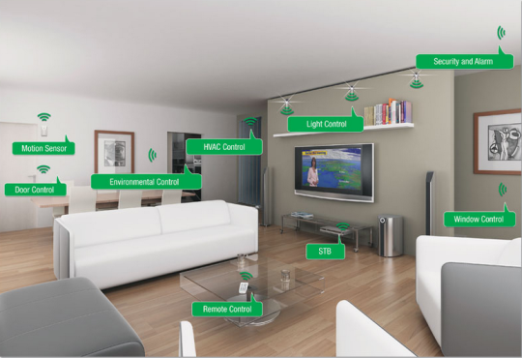
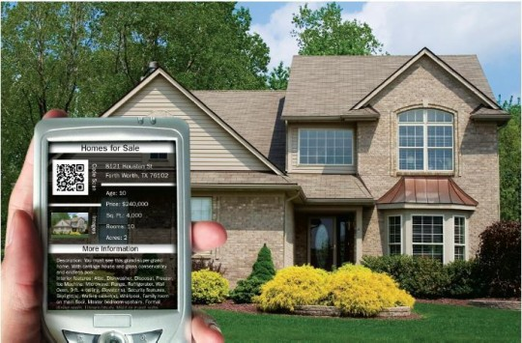
The Internet of Things
Sensor network evolution
^{[2]}
^{[1]}
^{[2]}
Special Purpose &
Research Networks
Commercial Automation Solutions
[1] http://www.cs.berkeley.edu/~binetude/ggb/
[2] http://siliconangle.com/blog/2013/06/04/2013-the-year-of-the-internet-of-things/
Notes:
Sensor networks have come a long way: Not only ‘custom built special purpose’ networks:
integration & interoperability become more important
Goal: Internet Of things: basically attach every sensor directly to the internet

Slide 73
The Internet of Things
Sensor network evolution
Existing requirements continue to exist
Interoperability ?
Interconnectivity ?
Ease of use ?
Internet of Things: Connect everything to the internet
Goal: end-to-end TCP/IP connectivity with smart devices
Industrial control systems, Smart Roads, …
Home automation:
TV, Lights, Heating, Smart metering, ..
Smart appliances: fridge, washing machine, ...
Smart clothes, food, …
Applies to sensor networks as well

Slide 74
6 LowPAN
IP in Sensor Networks
IPv4 = deprecated → Use IPv6 instead
IPv6 ⬄ IEEE 802.15.4
IEEE 802.15.4: max 127 byte frames
IPv6
Requires MAC-Layer to support 1280-byte packets
IPv6 Header is at least 40 bytes long
At least 48% overhead from IPv6 & UDP alone !!!
6LowPAN
23B
40B
8B
Max 53B
2B (FCS)
MAC
IPv6 Header
UDP
DATA

Slide 75
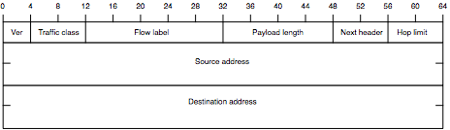
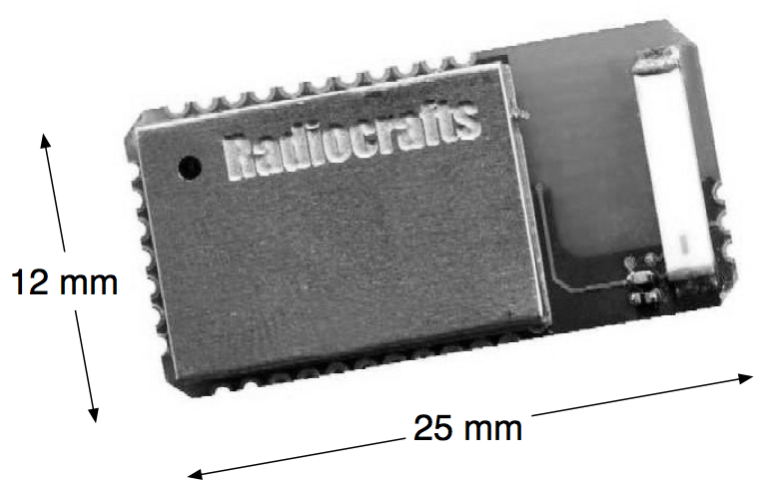
6LowPAN
6LowPAN: IPv6 over Low powered (personal) area networks
Adaptation layer between IEEE 802.15.4 and IPv6
Defined by IETF Standards
RFC4944, RFC6282, RFC6775
Stateless & Stateful IPv6 Header compression
Fragmentation
Low-power alternative to IPv6 Neighbour Discovery
End-to-end Internet integration
^{[1]}
IPv6
[1] Shelby, Zach, and Carsten Bormann. 6LoWPAN: The wireless embedded Internet. Vol. 43. Wiley. com, 2011.
Notes:
Remember: main goal of 6LowPan: reduce header size

Slide 76
6LowPAN
Protocol Stack
TCP/IP Protocol stack
6LowPAN Protocol stack
HTTP, VoIP, …
Application
CoAP, …
TCP
UDP
ICMP
Transport
UDP
ICMP
IPv4
IPv6
Network
IPv6
6LowPAN
Ethernet MAC
Data Link
IEEE 802.15.4 MAC
Ethernet PHY
Physical
IEEE 802.15.4 PHY
Notes:
Note: CoAP == Webservices for Sensor networks

Slide 77
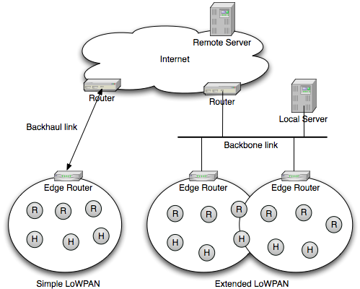
6LowPAN
Architecture
6LowPAN = ‘stub’ network
Standalone network with one or more internet uplinks
Does not route data for other networks
Each 6LowPAN network corresponds to an IEEE 802.15.4 PAN
^{[1]}
[1] Shelby, Zach, and Carsten Bormann. 6LoWPAN: The wireless embedded Internet. Vol. 43. Wiley. com, 2011.
Notes:
Stub network example: basically every home network in the world

Slide 78
6LowPAN
Two operating modes
Meshing Under
All nodes are on the same IPv6 link
6LowPAN handles meshing & multihop broadcasting
Routing Over
IPv6 links correspond to the underlying links
Routing & multicast are handled in IPv6
UDP
UDP
IPv6
IPv6
IPv6
IPv6
6LowPAN
6LowPAN
6LowPAN
6LowPAN
MAC
MAC
MAC
MAC

Slide 79
6LowPAN: Frame format
General Frame Structure
Stacked headers prefixed with dispatch byte
Identifies the header type
May contain header information
MAC
D
P
H1
D
P
H2
…
D
P
HN
DATA
Pattern Header Type
+------------+------------------------------------------------+
| 00 xxxxxx | NALP - Not a LoWPAN frame |
| 01 000000 | ESC - Additional Dispatch byte follows |
| 01 000001 | IPv6 - Uncompressed IPv6 Addresses |
| 01 000010 | LOWPAN_HC1 - LOWPAN_HC1 compressed IPv6 |
| 01 000011 | reserved - Reserved for future use |
| ... | reserved - Reserved for future use |
| 01 001111 | reserved - Reserved for future use |
| 01 010000 | LOWPAN_BC0 - LOWPAN_BC0 broadcast |
| 01 010001 | reserved - Reserved for future use |
| ... | reserved - Reserved for future use |
| 01 111110 | reserved - Reserved for future use |
| 01 1xxxxx | LOWPAN_IPHC - LOWPAN_IPHC compressed IPv6 |
| 10 xxxxxx | MESH - Mesh Header |
| 11 000xxx | FRAG1 - Fragmentation Header (first) |
| 11 001000 | reserved - Reserved for future use |
| ... | reserved - Reserved for future use |
| 11 011111 | reserved - Reserved for future use |
| 11 100xxx | FRAGN - Fragmentation Header (subsequent)|
| 11 101000 | reserved - Reserved for future use |
| ... | reserved - Reserved for future use |
| 11 111111 | reserved - Reserved for future use |
+------------+------------------------------------------------+
Value has changed since original specification
Deprecated
Replacement
Figure 2 from RFC 4944, updated with new information from RFC 6282
Notes:
Remember: main goal of 6LowPan: reduce header size

Slide 80
6LowPAN: Frame format
Mesh Header
Used to ‘mesh under’ an IPv6 link
Uses 16/64-bit IEEE 802.15.4 addresses
V/F bits: indicate whether short or extended addresses are used
Previous & Next hop information retrieved from MAC Header
Broadcast Header
Used for ‘mesh under’ multihop broadcasting
0 1 2 3
0 1 2 3 4 5 6 7 8 9 0 1 2 3 4 5 6 7 8 9 0 1 2 3 4 5 6 7 8 9 0 1
+-+-+-+-+-+-+-+-+-+-+-+-+-+-+-+-+-+-+-+-+-+-+-+-+-+-+-+-+-+-+-+-+
|1 0|V|F|HopsLft| originator address, final address
+-+-+-+-+-+-+-+-+-+-+-+-+-+-+-+-+-+-+-+-+-+-+-+-+-+-+-+-+-+-+-+-+
0 1
0 1 2 3 4 5 6 7 8 9 0 1 2 3 4 5
+-+-+-+-+-+-+-+-+-+-+-+-+-+-+-+-+
|0|1|LOWPAN_BC0 |Sequence Number|
+-+-+-+-+-+-+-+-+-+-+-+-+-+-+-+-+
Notes:
Note: first 8 bits are the Dispatch byte

Slide 81
6LowPAN: Frame format
Fragmentation headers
First fragment:
Next fragments:
Used when an IPv6 packet does not fit in a single MAC frame
Datagram tag: identifies all fragments of the same packet
0 1 2 3
0 1 2 3 4 5 6 7 8 9 0 1 2 3 4 5 6 7 8 9 0 1 2 3 4 5 6 7 8 9 0 1
+-+-+-+-+-+-+-+-+-+-+-+-+-+-+-+-+-+-+-+-+-+-+-+-+-+-+-+-+-+-+-+-+
|1 1 0 0 0| datagram_size | datagram_tag |
+-+-+-+-+-+-+-+-+-+-+-+-+-+-+-+-+-+-+-+-+-+-+-+-+-+-+-+-+-+-+-+-+
0 1 2 3
0 1 2 3 4 5 6 7 8 9 0 1 2 3 4 5 6 7 8 9 0 1 2 3 4 5 6 7 8 9 0 1
+-+-+-+-+-+-+-+-+-+-+-+-+-+-+-+-+-+-+-+-+-+-+-+-+-+-+-+-+-+-+-+-+
|1 1 1 0 0| datagram_size | datagram_tag |
+-+-+-+-+-+-+-+-+-+-+-+-+-+-+-+-+-+-+-+-+-+-+-+-+-+-+-+-+-+-+-+-+
|datagram_offset|
+-+-+-+-+-+-+-+-+

Slide 82
6LowPAN: IPv6 Header compression
Full IPv6/UDP Headers: 48 Bytes
Minimal LowPAN Headers: 6 Bytes
Version
Traffic Class
Flow Label
Dispatch + Lowpan_IPHC
Lowpan_NHC
SP
DP
Payload Length
Next Header
Hop Limit
Checksum
Payload
Source Address
Destination Address
Source Port
Destination Port
UDP Length
Checksum
Payload
Notes:
Remember: main goal of 6LowPan: reduce header size

Slide 83
6LowPAN: IPv6 Header compression
Compression techniques
Strip out non-essential fields:
Traffic Class, Flow label, Hop limit, …
header / payload lengths: can be calculated from packets size
Reduce size of other fields:
IPv6 address fields: can be compresses or removed altogether
64-bit prefix: same for all nodes in the network → not needed
64-bit device-id: can be calculated from the MAC-address
UDP source / destination ports: can be reduced to 4 bits each
Next header field: can be reduced to a few bits
Compression can be enabled/disabled/configured for each field individually

Slide 84
6LowPAN: IPv6 Header compression
Base Header
+-------------------------------------+------------------------
| Dispatch + LOWPAN_IPHC (2-3 octets) | Compressed IPv6 Header
+-------------------------------------+------------------------
LOWPAN_IPHC Encoding
0 1 2 3 4 5 6 7 8 9 0 1 2 3 4 5
+---+---+---+---+---+---+---+---+---+---+---+---+---+---+---+---+
| 0 | 1 | 1 | TF |NH | HLIM |CID|SAC| SAM | M |DAC| DAM |
+---+---+---+---+---+---+---+---+---+---+---+---+---+---+---+---+
TF = Traffic Class, Flow Label
NH = Next Header Flag
HLIM = Hop Limit
CID = Context Identifier Extension
SAC = Source Address Compression
SAM = Source Address Mode
M = Multicast Compression
DAC = Destination Address Compression
DAM = Destination Address Mode
Shelby, Zach, and Carsten Bormann. LoWPAN: The wireless embedded Internet. Vol. 43. Wiley. com, 2011.
Notes:
The short explanation:
-LowPAN_IPHC specifies fields present + type of compression, compressed fields placed after IPHC
-Traffic class + flowid : 3 different compression modes or not present
-Next Header: specifies if next header is also compressed (not -> normal IPv6 from now on)
-Hop limit: either 1, 64, 255 or specified in separate byte
-Remainder: source & destination addessing

Slide 85
6LowPAN: IPv6 Header compression
IPv6 Address compression
IPv6 Address:
Prefix compression:
None: full prefix is present
Stateless: assume link-local prefix
Statefull: predefined prefix
Specified by a 4-bit Context Identifier
Interface ID representation
64-bit: full Interface ID is stored in the packet
16-bit: only the 16 least significant bits are stored
Other bits are either a fixed prefix or known through the Context Identifier
None: IEEE 802.15.4 address is used as Interface ID
Retrieved from MAC or LowPAN meshing header
64-Bit Prefix
64-Bit Interface ID

Slide 86
6LowPAN: IPv6 Header compression
LowPAN_NHC: Next-header compression
Compression format for popular headers
IPv6 Extension Headers:
EID: identifies the header type:
Hop-by-hop, routing, fragmentation, …
NH: whether or not the next header is compressed
+----------------+---------------------------
| var-len NHC ID | compressed next header...
+----------------+---------------------------
0 1 2 3 4 5 6 7
+---+---+---+---+---+---+---+---+
| 1 | 1 | 1 | 0 | EID |NH |
+---+---+---+---+---+---+---+---+

Slide 87
6LowPAN: IPv6 Header compression
UDP Header compression:
Conforms to LOWPAN_NHC
Checksum can be removed under certain circumstances
Port Compression:
Source & Destination ports can be compressed to 4 bits each
Stateless compression, no context information
0 1 2 3 4 5 6 7
+---+---+---+---+---+---+---+---+
| 1 | 1 | 1 | 1 | 0 | C | P |
+---+---+---+---+---+---+---+---+

Slide 88
6LowPAN: Neighbour Discovery
RFC 4861: Neighbour Discovery for IPv6
Used for ‘Bootstrapping’ IPv6 nodes
Node broadcasts ‘Router Solicitation’
Router answers with ‘Route Advertisement’
Contains IPv6 Prefix & Route information
Node chooses IPv6 address based on prefix info & Interface ID
Node broadcasts ‘Neighbour Solicitation’ with chosen address
No reply → safe to use address
R
R.Adv
H
H
H
H
H
R.Soll
R.Soll
R.Soll
R.Soll
N.Soll
N.Soll
N.Soll
N.Soll

Slide 89
6LowPAN: Neighbour Discovery
RFC 4861: Neighbour Discovery for IPv6
Used for ‘Bootstrapping’ IPv6 nodes
Used for L3→L2 address resolution
Node broadcasts ‘Neighbour Sollicitation’
Contains the IPv6 address to be resolved
Owner of the IPv6 address replies with ‘Neighbour Advertisment’
Contains L2 address corresponding to the IPv6 address
R
H
H
H
H
N.Adv
N.Soll
N.Soll
N.Soll
N.Soll

Slide 90
6LowPAN: Neighbour Discovery
Can we use RFC 4861 in LowPANs ?
IPv6 link-local multicast = LowPAN wide broadcast
Network is flooded each time
A Router Solliciation is sent
A L3 → L2 address translation is performed
Node movement within the LowPAN triggers address reconfiguration
RFC4861 has no support for statefull address compression
RFC 6775: Neighbour Discovery for 6LowPANs
Notes:
Note1: IPv6 Broadcasts are translated into LowPAN wide multihop broadcasts

Slide 91
6LowPAN: Neighbour Discovery
Network Structure:
Route-Over:
6LBR: 6LowPAN Border Router
Connects the LowPAN to the outside world
Responsible for prefix propagation in the LowPAN
6LR: 6LowPAN Router
Forwards IPv6 Packets within the LowPAN
Aids in Multihop Neighbour Discovery
6LN: 6LowPAN Node
End nodes in the LowPAN
Mesh-Under: no 6LR’s present
Entire LowPAN is treated as a single IPv6 Link
6LBR
6LR
6LN
6LR
6LN
6LR
6LN
6LN
6LN

Slide 92
6LowPAN:
Modifications to Neighbour Discovery messages
6CO: 6LowPAN Context Option
New option for Route Advertisements
Contains statefull address compression context information
ARO: Address Registration option
New option for Neighbour Sollicitations
Allows 6LH’s to register their addresses with a 6LR
ABRO: Authorative Border Router Option
IPv6 Option for Route Advertisements
Used to announce the 6LBR in the LowPAN
Full list: see RFC 6775

Slide 93
6LowPAN: Neighbour Discovery
Bootstrapping
6LN broadcasts router sollicitation
6LRs in reach reply with router advertisement
Contains ABRO, 6CO & prefix information
6LN Registers its addresses with one or more 6LRs
Unicasts ‘Neighbour Solicitation’ containing ARO
6LR asks 6LBR if the IPv6 address is already in use
6LBR replies to 6LR
6LR Sends ‘Neighbour Advertisement’ to 6LH
Contains ARO: status indicates registration success/failure
The 6LN may now start acting as a 6LR to other nodes
Note: 64 bit MAC addresses are assumed to be unique
6LBR check is skipped for 64-bit MAC addresses
6LBR
DAC
6LR
6LR
6LR
R.Adv
DAR
N.Adv
6LN
6LN
6LN
6LR
R.Soll
R.Soll
N.Soll

Slide 94
6LowPAN: Neighbour Discovery
L3 → L2 Address resolution
Each 6LH learns the L2 addresses of its 6LRs through the registration process
6LRs register their addresses with their 6LR neighbours
This is done in exactly the same manner as 6LH address registration
Further Reading
RFC4944: The original 6LowPAN specification
RFC6282: Revisions to the 6LowPAN specification
RFC6775: Neighbour Discovery for 6LowPANs

Slide 95
Sensor network platforms

Slide 96
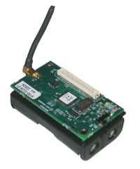
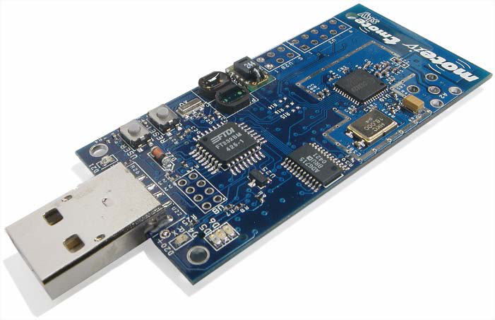
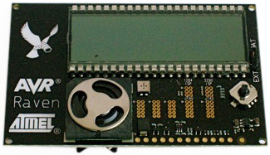
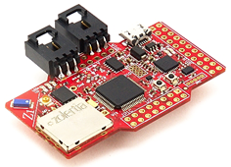
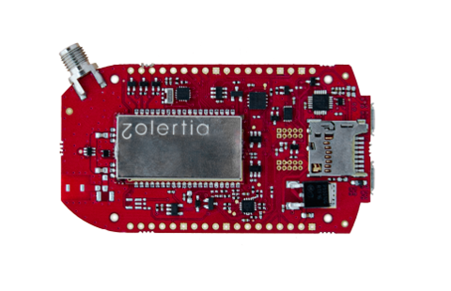
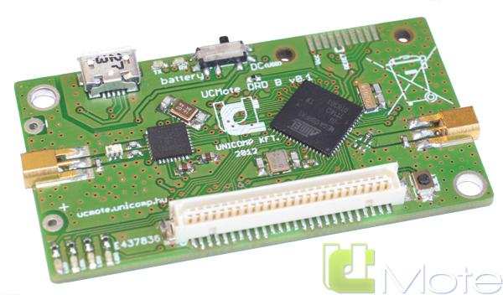
Typical sensor nodes
MicaZ
4K RAM 128K Flash
Tmote SKY
10K RAM
48K Flash
AVR Raven
16K RAM 128K Flash
UCMote ProtonB
16K RAM 128K Flash
Zolertia Z1
8K RAM
96K Flash
Zolertia Re-Mote
32K RAM
512K Flash
Notes:
-Some examples of sensor nodes
(shown from old->new)
-limited in capabilities even for recent ones
-originally: needed to save power, still the case
-secondly: cost cheaper components -> lower price per node -> in this case: higher profit

Slide 97
Operating Systems
Challenges for the sensor network OS:
Code & memory space
Nodes are often custom-built, special-purpose hardware
→ no OS will work ‘out of the box’
Missing hardware features:
Memory Management Unit (MMU)
Protected access mode
Device drivers
Applications often require low level access to devices
→ Not uncommon NOT to use an OS at all
Notes:
Problems for os:
space: try fitting the linux kernel in 10k ram…
hardware is special purpose → even if you have an os: requires tweaking / hacking to get it working on your platform
not all features required by an OS are present most prominent
-MMU (if you have this, you are probably running linux)
-protected access mode
device drivers: ideally: shielded from application but try implementing TDMA with micro-second accuracy without low-level access to the devices
Not uncommon for an application NOT to use an OS at all (depending on the specific application)
If you have specialised hardware that only needs to perform a single function and you’re the only one who is going to use it: why bother with an OS ?
Do you have to start from scratch every time: no
Quite a number of Osses exist but they are quite different from a traditional OS

Slide 98
Operating Systems
Sensor node OS: More framework than OS
Provides OS-like features but end-control lies with the application itself.
Does not have the capabilities of a ‘traditional OS’
Memory protection ? NO
Dynamic memory allocation ? Maybe
No MMU, no paging → extremely limited
Multithreading ? Maybe
Some provide it, others offer task scheduling
OS handles most of the dirty details but:
In the end the application can do whatever it wants
Offers no protection against screwups
Notes:
Do you have to start from scratch every time: no
Quite a number of Osses exist but they are quite different from a traditional OS
Osses: do not provide everything you would expect
Best way to look at it: a framework that includes some of the things you would expect an OS to do into your application image
Single image built from a collection of application code & libraries
Dynamic memory: some do, some don’t: remember no virtual memory, → all the issues solved with paging / virtual memory come back into play again (fragmentation, …)
not available / not used most of the time
Multi-process support: none single-application --> shouldn’t be necessary
No memory protection: no MMU
Multithreading: some provide it some don’t
Alternative: task scheduling within a single thread
Scheduling:
Helps you, but won’t prevent you from messing up
Eg: 0x0 is considered to be a valid pointer address
Want to write outside your allocated memory ? : go right ahead
Busy loop -> hangs the entire node, but go right ahead
Debugging: very limited capabilities: usually nothing more than some leds & printf
Stepping / tracing requires specialized HW, shuts down the entire MCU, not only the piece of code you are looking at
Dynamic module loading??

Slide 99
Operating systems
TinyOS
The first sensor network OS
Basic OS Features:
Non-preemptive Task scheduler & Timers
No dynamic memory
No real-time support
nesC language: modular version of C designed for extreme reusability
Geared at sensor network prototyping & research
Suitable for extremely low-power devices
Fully fledged but non standard-compliant network stack:
CSMA/CA or LPL-MAC, 6LowPAN & CoAP
Still used but not as actively maintained as it used to be
Further reading: http://www.tinyos.net

Slide 100
Operating Systems
Contiki-OS
Wider range of OS Features
Scheduling:
Protothreads: threads without a stack
Non-preemptive multithreading (limited support)
Limited dynamic memory support
Allocation within statically defined buffer
malloc(): only for a few specific platforms
Dynamic module loading: Best considered as ‘Experimental’
Basic filesystem & multi-application support
Most ‘advanced’ features are only available on a few specific platforms
Notes:
Note: contiki has the habbit of implementing features half-heartedly for one or two platforms and than flatly saying that they support it → keep your eyes open

Slide 101
Operating Systems
Contiki-NG: “Contiki for the next generation of IoT devices”
Fork of original Contiki-OS code
Basic principles are the same but not backwards compatible
Drops support for “ancient” sensor platforms
Drops support for outdated network stacks
Adds support for newer sensor platforms (e.g. Zolertia Re-Mote)
Add support for IEEE 802.15.4 TSCH
You’ll be using Contiki-NG in this course
Notes:
Note: Contiki-OS has three separate network stacks…

Slide 102
Contiki
Protothreads:
Conceptually: ‘Stateless threads’
Execution stack is only available while the thread is running
When the thread is paused, only the program-counter is preserved
Non-preemptive:
State is lost on context switch
thread itself decides when this occurs
Thread only pauses while waiting for an event to occur

Slide 103
Contiki: Protothreads example
#include "pt.h"
PT_THREAD(sender(struct pt *pt))
{
PT_BEGIN(pt);
while(keep_running) {
PT_WAIT_UNTIL(pt,
key_pressed());
send_packet();
timer_set(&timer, TIMEOUT);
PT_WAIT_UNTIL(pt,
timer_expired(&timer));
}
PT_END(pt);
}
#include "pt.h"
char sender(struct pt *pt)
{
switch(pt->lc)
{
case 0:
while(keep_running) {
pt->lc = 7;
case 7:
if(!key_pressed())
return 0;
send_packet();
timer_set(&timer, TIMEOUT);
pt->lc = 10;
case 10:
if(!timer_expired(&timer))
return 0;
}
}
pt->lc = 0
return 3;
}
Notes:
-Show left code first: explain what conceptually everything does
-PT_THREAD: Declare a new thread
-PT_BEGIN: thread execution starts here, place nothing in front of it for reasons that will become aparent very shortly
-PT_WAIT_UNTIL: wait until a specific condition is true, other commands for suspending execution also exist
-PT_END: thread execution stops here
-Finished thread may be rescheduled once completed
How did they do this: ? This is pure C-code → Macro magic
-Show on right side what the code translates to
- is code directly from gcc, with a few unnecessary statements removed && with some code cleanup added
-Highligt macro expansion: show original code is still there
-Hide it & explain:
-Each PT_THREAD == function that is called by the task scheduler whenever it needs to do something
-Makes use of extremely dirty trick in C: select statement does NOT what we would expect it to do:
-Select is not something that executes a block of code based on a value
-it jumps to a specific line in a block of code based on a value
-may contain if’s while, for’s, …→ select is very similar to GOTO’s
-PT_BEGIN: start switch statement: pt→lc represents the Program counter: eg: where we are in the thread
-whenever we yield: store the current position by adding a ‘case’ statement, storing the value & returning
-next time function is invoked: ‘thread’ continues where it left off

Slide 104
Contiki
Protothreads
From the programmer’s point of view: lightweight thread
Code structure mimics that of thread-based programming
From the scheduler’s point of view: tasks
Each ‘protothread’ is a task to be repeatedly scheduled for execution
Drawbacks
No state:
local variables are cleared when the thread yields
→ use static variables if the value needs to survive a ‘yield’
Thread can only be yielded at the top-most level
Functions called from the protothread cannot yield the thread
Waiting for an event may prevent the CPU from entering sleep-mode
The protothread is rescheduled until the event has occurred

Slide 105
Contiki-NG Network stack
Monolithic Network stack
Some choice in components
Difficult to add new ones
Network Layer
6LowPAN + IPv6 + RPL
6LowPAN
Adaptation layer
Compresses / extracts packets on-the-fly
RPL: routing protocol
Partial implementation
RPL spec. is very big
MAC Layer
Choice of either TSCH or CSMA/CA
Application
HTTP
…
CoAP
uIPv6
RPL
TCP
UDP
ICMPv6
IPv6
6LowPAN
MAC Layer
CSMA/CA
TSCH

Slide 106
Contiki
CooJa: Contiki Network Simulator
Event-based simulator
Sensor node VM
Emulates device hardware
Interprets sensor node byte-code directly
→Image in VM == Image on device
Powerfull debugging & research tool
Further Reading
http://contiki-ng.org/
https://github.com/contiki-ng/contiki-ng/wiki
Contiki-NG source code:
https://github.com/contiki-ng/contiki-ng
Notes:
Event based → all event which can occur: sending of a packet, timer being fired button being pressed: all processed individually
-all events stored in order in an event queue, processed in order across the entire network
-simulated time != real time: may be faster / slower depending on #nodes, #events
-main advantage: does not depend on host timer --> adding more nodes slows the sim down, but does not invalidate the results
Sensor node VM
-interprets compiled code just like eg Java VM interprets java byte code
-image in vm same as one deployed on the device → very little differences between VM & real behavior → extremely powerful debugging tool even for mu

Slide 107
Operating Systems
Riot-OS
Internet-of-Things-OS:
Develop on PC, deploy on sensor node
Supports both C & C++
Supports multithreading & dynamic memory
http://www.riot-os.net
FreeRTOS: Free Real-Time OS
Designed for commercial usage
Multithreading & Dynamic memory
Priority Thread scheduler
E. Usage often less of a concern
MCU’s are usually a bit more powerful
http://www.freertos.org
Notes:
RiOT OS: Nice idea, but not really meeting its goals yet (eg STL not fully supported)
FreeRTOS: along for quite a while
-focus on commerial embedded development
-eg: MCU in oven, washing machine, …
-other priorities:
-starting point for product development
-learning curve ?, easy to use: ?
-not uncommon to hack around with makefiles & write some own headers

Slide 108
What will you do?

Slide 109
What will you do?
You will research TSCH sensor networks
Using 6TiSCH “minimal configuration” stack: TSCH, 6top sublayer, RPL
Using Contiki-NG
Using the Zolertia RE-Mote (868 MHz & 2.4 Ghz)
You will answer different research questions throughout the year
What is the effect of parameter X on metric Y?
Which (set of) parameters performs best in terms of metric X?
How can you improve metric X?
…

Slide 110
What will you do?
You will write your results down in a scientific paper
Paper should be at least 5 pages 2-column IEEE style
Template available on blackboard
A conference-ready paper containing:
What you investigated
A description of your test setup
Explain not only the how but also the why
Your results + explanation

Slide 111
Practical organisation
Contact information:
Glenn Daneels: glenn.daneels@uantwerpen.be
Carmen Delgado: carmen.delgado@uantwerpen.be
Teams of two/three people
Same team ≈ same grade
Report problems immediately
We hear nothing = everything is ok
Submit your groups by e-mail by the end of the week
Send your e-mail to: glenn.daneels@uantwerpen.be

Slide 112
Practical organisation
If problems arise with the software or hardware
Look in the documentation & source code
Ask Google
Send us an e-mail (glenn.daneels@uantwerpen.be)
Don’t wait until it’s too late
If problems arise your partner(s)
Contact us ASAP
We hear nothing = all went well

Slide 113
Timing
Project starts now
Throughout the year you will get different research questions
Deadline final paper
The day before the Christmas holiday
During exam period
Presentation on results

Slide 114
What is your first assignment?
Obligatory reads:
Vilajosana, Xavier, et al. "IETF 6TiSCH: A Tutorial." IEEE Communications Surveys & Tutorials (2019).
Duquennoy, Simon, et al. ”TSCH and 6TiSCH for Contiki: Challenges, design and evaluation." 2017 13th International Conference on Distributed Computing in Sensor Systems (DCOSS). IEEE, 2017.
Papers are available on Blackboard
→ You want to learn more? See http://scholar.google.be and look for keywords such TSCH, 6TiSCH, RPL, Contiki, 6top, etc.

Slide 115
What is your first assignment?
Get to know the firmware:
https://github.com/contiki-ng
Obligatory: Set up Contiki-NG on your system:
https://github.com/contiki-ng/contiki-ng/wiki#setting-up-contiki-ng
Get to know the hardware:
https://github.com/contiki-ng/contiki-ng/wiki/Platform-zoul
Obligatory: Get the “Hello, World!” Example running
https://github.com/contiki-ng/contiki-ng/wiki/Tutorial:-Hello,-World!
Make sure that you get it running as a native node at the very least
Also try to run it on the Zolertia nodes
Not a problem if it doesn’t work yet

Slide 116
First meeting
We will have a first meeting where you will show your progress and ask your questions:
At “The Beacon” campus (Sint-Pietersvliet 7, 2000 Antwerpen)
Bring your sensors and laptops
Select the slots you are available by the end of the week (13/10): https://doodle.com/poll/smmr8tdnm2hfunr6

Slide 117

Questions ?

